Slide 1
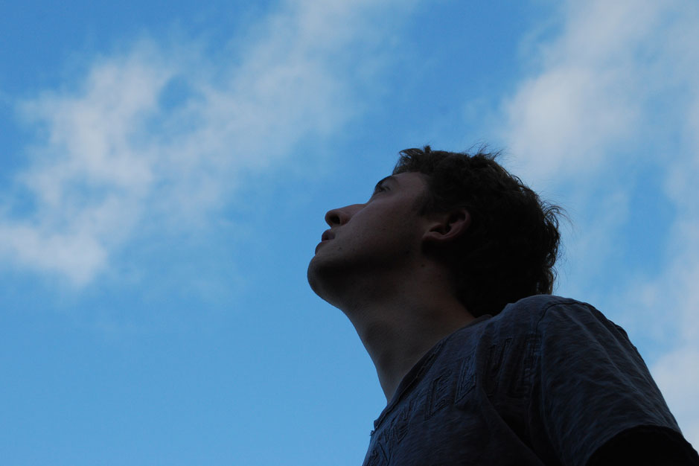
Things Are Looking Up:
A Study of Colossians 3:1-4

Slide 2
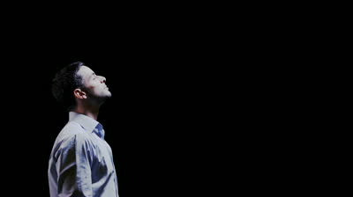
The Situation Is Looking Up

Slide 3
The Situation Is Looking Up
The journey begins with a condition (vs. 1)
  Requires knowing the prelude
    Colossians 2:12
    Colossians 2:23
We know to whom we should look up
  Christ has taken His position, seated with Father
  Psalm 110

Slide 4
The Situation Is Looking Up
The journey begins with a condition (vs. 1)
  Requires knowing the prelude
    Colossians 2:12
    Colossians 2:23
We know to whom we should look up
  Christ has taken His position, seated with Father
Baptism, which corresponds to this, now saves you, not as a removal of dirt from the body but as an appeal to God for a good conscience, through the resurrection of Jesus Christ, who has gone into heaven and is at the right hand of God, with angels, authorities, and powers having been subjected to him. – I Peter 3:21-22

Slide 5
The Situation Is Looking Up
The journey begins with a condition (vs. 1)
  Requires knowing the prelude
    Colossians 2:12
    Colossians 2:23
We know to whom we should look up
  Christ has taken His position, seated with Father
And now, Father, glorify me in your own presence with the glory that I had with you before the world existed. – John 17:5

Slide 6
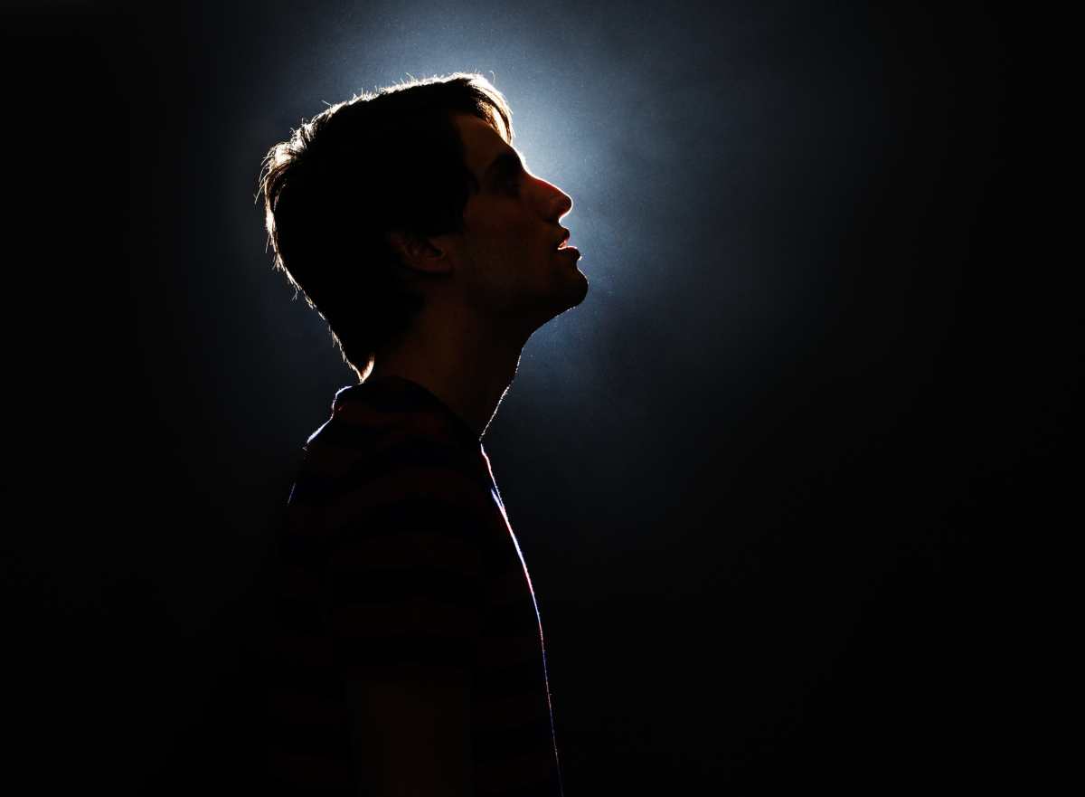
Our Mindset Is Looking Up

Slide 7
Our Mindset Is Looking Up
Set your mind on things above
  Jesus must come first
But he turned and said to Peter, “Get behind me, Satan! You are a hindrance to me. For you are not setting your mind on the things of God, but on the things of man.” – Matthew 16:23

Slide 8
Our Mindset Is Looking Up
Set your mind on things above
  Jesus must come first
Do not lay up for yourselves treasures on earth, where moth and rust destroy and where thieves break in and steal, but lay up for yourselves treasures in heaven, where neither moth nor rust destroys and where thieves do not break in and steal.
– Matthew 6:19-20

Slide 9
Mindset
For many, of whom I have often told you and now tell you even with tears, walk as enemies of the cross of Christ. Their end is destruction, their god is their belly, and they glory in their shame, with minds set on earthly things. -- Philippians 3:18-19
Enemies of Christ
Treasures On Earth

Slide 10
Mindset
Live in harmony with one another. Do not be haughty, but associate with the lowly. Never be wise in your own sight. -- Romans 12:16
Enemies of Christ
Places Thoughts Above Christ
Treasures On Earth

Slide 11
Mindset
For those who live according to the flesh set their minds on the things of the flesh, but those who live according to the Spirit set their minds on the things of the Spirit. For to set the mind on the flesh is death, but to set the mind on the Spirit is life and peace. For the mind that is set on the flesh is hostile to God, for it does not submit to God's law; indeed, it cannot. ⁸Those who are in the flesh cannot please God.
-- Romans 8:5-8
Enemies of Christ
Places Thoughts Above Christ
Leads to death
Treasures On Earth

Slide 12
Mindset
Treasures In Heaven
Jesus comes first
Have this mind among yourselves, which is yours in Christ Jesus -- Philippians 2:5

Slide 13
Mindset
Treasures In Heaven
Jesus comes first
Only way to success
Now set your mind and heart to seek the Lord your God. Arise and build the sanctuary of the Lord God, so that the ark of the covenant of the Lord and the holy vessels of God may be brought into a house built for the name of the Lord.” – I Chronicles 22:19

Slide 14
Mindset
Treasures In Heaven
Jesus comes first
Only way to success
Requires work
Therefore, preparing your minds for action, and being sober-minded, set your hope fully on the grace that will be brought to you at the revelation of Jesus Christ. – I Peter 1:13

Slide 15
Our Mindset Is Looking Up
How Can I Know My Mind Is Set On Christ?
  How I view things on earth
  Truthful evaluation of thinking
Finally, brothers, whatever is true, whatever is honorable, whatever is just, whatever is pure, whatever is lovely, whatever is commendable, if there is any excellence, if there is anything worthy of praise, think about these things. -- Philippians 4:8

Slide 16
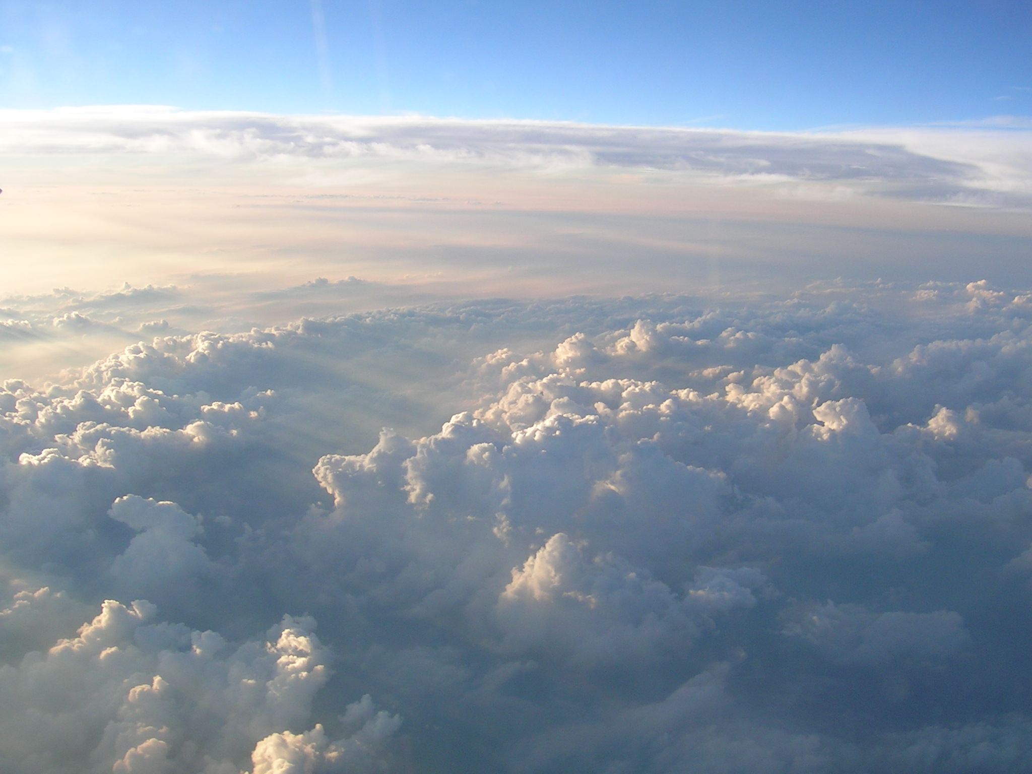
Seeking Things That Are Above

Slide 17
Seeking Things That Are Above
Seeking can only follow a set mind
What you have learned and received and heard and seen in me—practice these things, and the God of peace will be with you. – Philippians 4:9

Slide 18
Seeking Things That Are Above
Seeking can only follow a set mind
He will render to each one according to his works: to those who by patience in well-doing seek for glory and honor and immortality, he will give eternal life – Romans 2:6-7

Slide 19
Seeking Things That Are Above
Seeking can only follow a set mind
Always present tense – “Keep on seeking”
Seen In:
  Loving my neighbor, enemy, family, brethren
  Being zealous for good works
  Participating in public worship and Bible study
  Doing all things for Christ by Christ’s standards

Slide 20

Our Future Is Looking Up

Slide 21
Our Future Is Looking Up
Change of mindset unnoticed by world (3:3)
Christ is my life
And this is the testimony, that God gave us eternal life, and this life is in his Son. Whoever has the Son has life; whoever does not have the Son of God does not have life. – I John 5:11-12

Slide 22
Our Future Is Looking Up
Change of mindset unnoticed by world (3:3)
Christ is my life
What is hidden will be made known (3:4b)
  Those who look hopeless will be vindicated!

Slide 23

In Which Direction Are You Looking?

